Slide 1
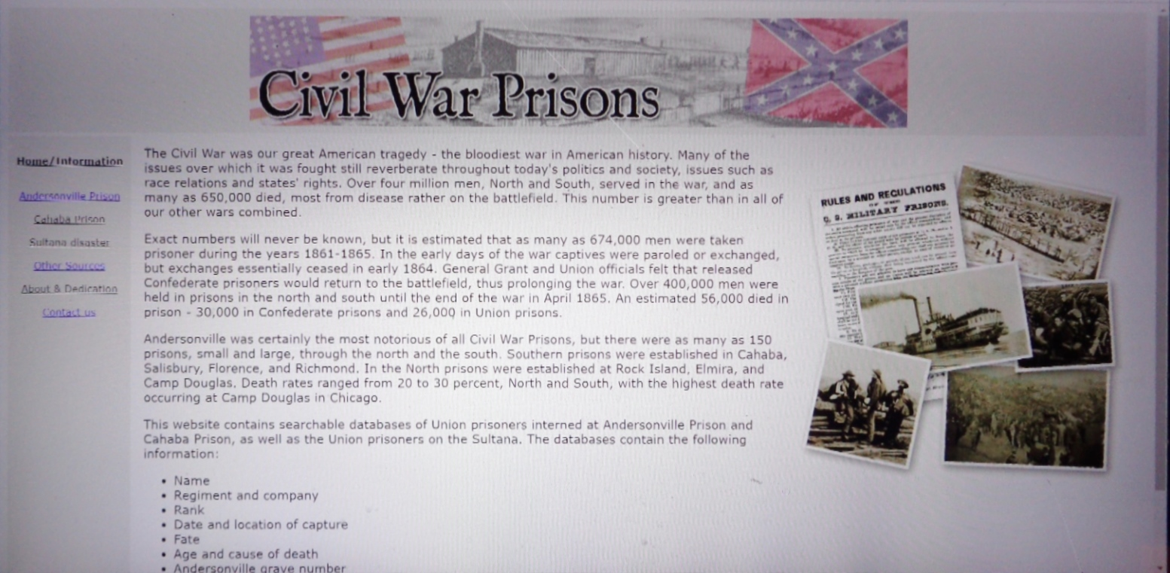
Civil War Prisons Homepage

Slide 2
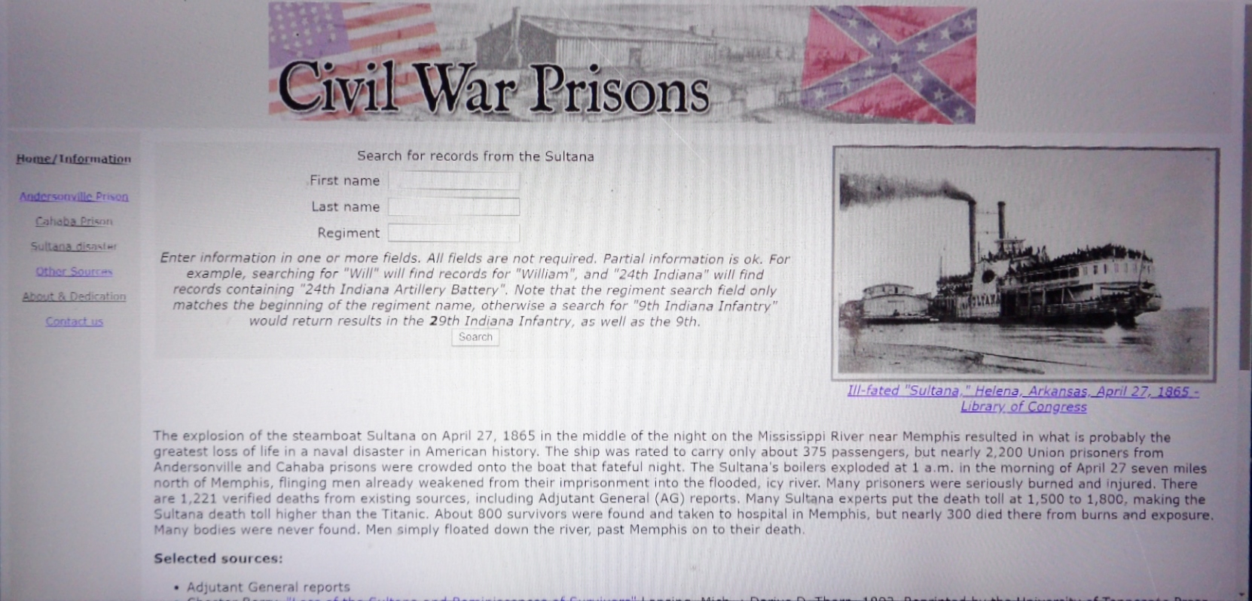
Civil War Prisons Sultana Search Page

Slide 3
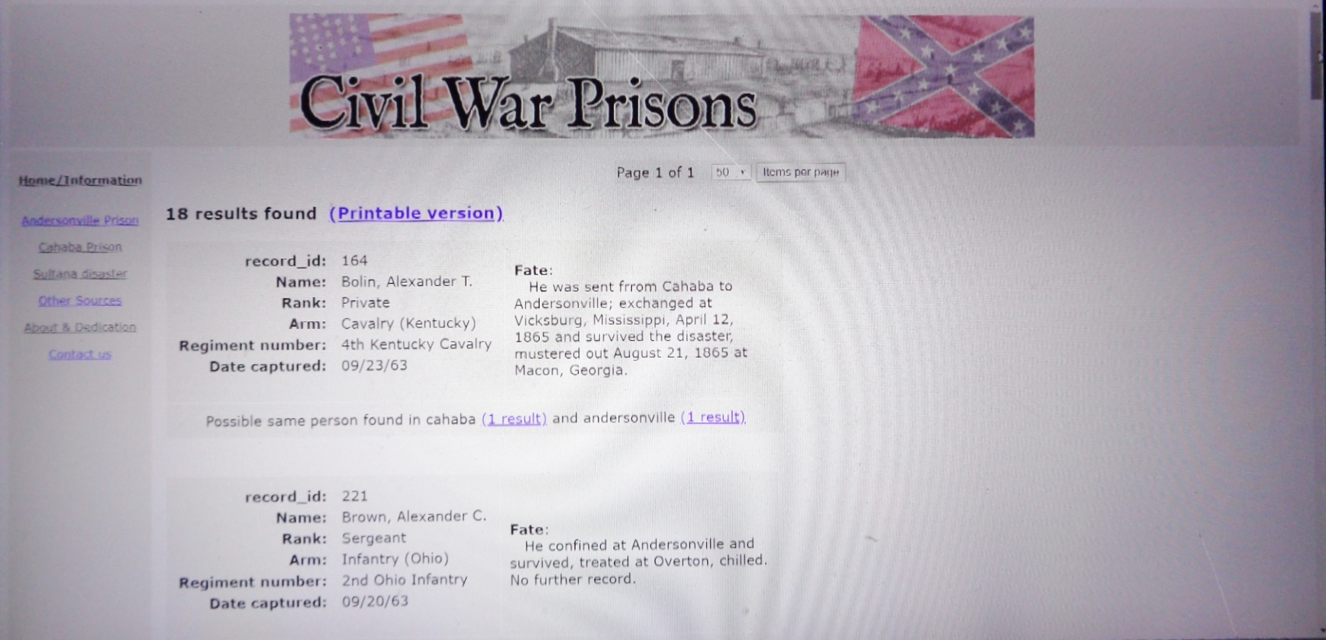
Civil War Prisons - Sultana Records Search - search for first name “Alexander”

Slide 4
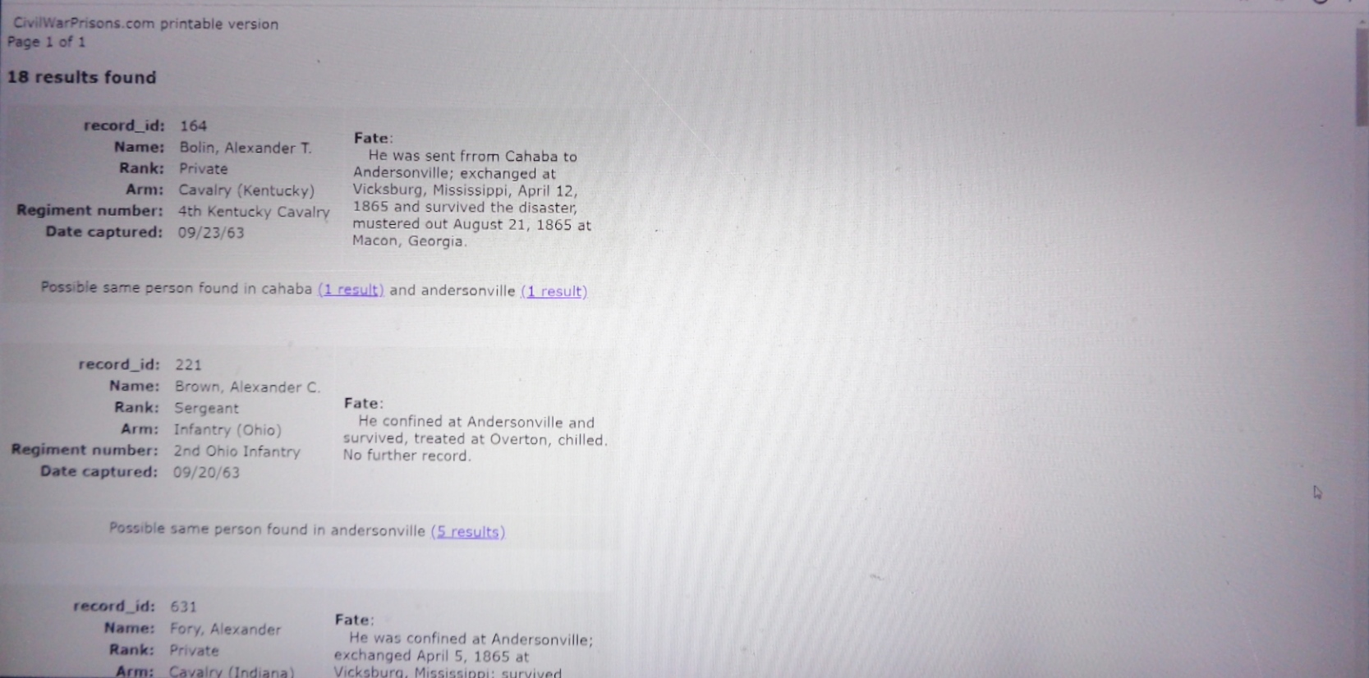
Civil War Prisons - Sultana Records Search - search for first name “Alexander”
(Printable Version)

Slide 5
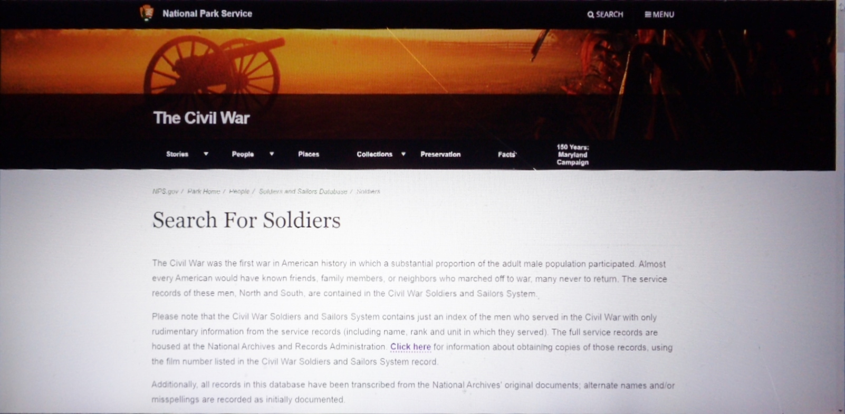
National Park Service – The Civil War – Top of Homepage

Slide 6
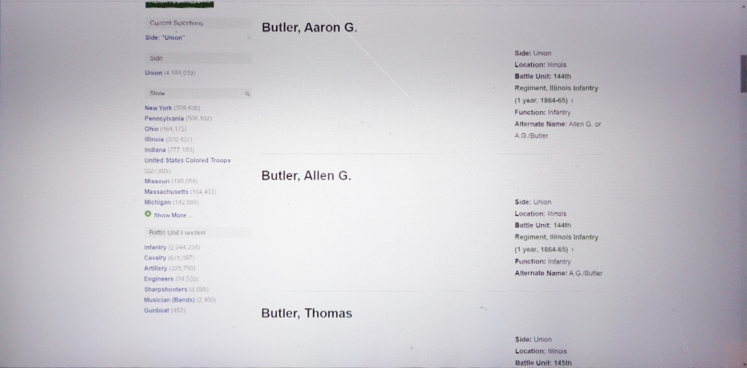
National Park Service – The Civil War – search for last name “Butler”

Slide 7
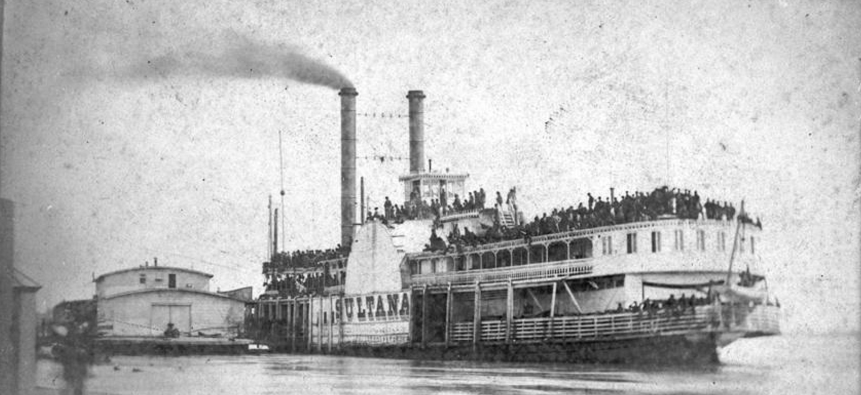
Sultana Disaster Museum Database
At 2:00 a.m. on April 27, 1865, when the sidewheel Mississippi steamboat Sultana was seven miles above Memphis, TN, her boilers exploded. Shortly thereafter the boat caught fire, eventually sinking near 7:00 a.m. On board were 1,960 recently paroled Union ex-prisoners of war, 22 guards of the 58th Ohio Infantry, 70 civilian passengers, and 85 crew, a total of 2,137 on a boat legally registered to carry 376 passengers and a crew of about 100.
Out of that total, 1,168 people perished. The Sultana Disaster is the greatest maritime disaster in American history.

Slide 8
Sultana records search.
Enter information in one or more of the search boxes. Not all boxes need to be filled out. Partial searches are acceptable. Example: a search for the first name “Alex” will bring up all people with the name “Alex” and “Alexander”.
First Name
Last Name
State and Unit Type
(includes Crew, Passengers, and Guards)
(drop down menu)
Unit Number
Company Letter
(drop down menu)
Note: Indiana artillery batteries do not have a company letter.
Held Prisoner At:
(drop down menu)

Slide 9
Drop down menu for “State” category
Passenger
Crew
Guard – 58th Ohio Infantry
Iowa Cavalry
Illinois Infantry
Indiana Artillery Battery
Indiana Cavalry
Indiana Infantry
Kentucky Cavalry
Kentucky Infantry
Kentucky Light Artillery
Kentucky Mounted Infantry
Michigan Cavalry
Michigan Engineers & Mechanics
Michigan Infantry
Michigan Light Artillery
Michigan Sharpshooters
New York Infantry
Ohio Cavalry (McLaughlin)
Ohio Cavalry
Ohio Infantry
Ohio Light Artillery
Pennsylvania Cavalry
Tennessee Cavalry
Tennessee Infantry
Tennessee Mounted Infantry
United States Colored Troops
Virginia (Louden County Virginia Rangers)
West Virginia Cavalry
West Virginia Infantry
West Virginia Light Artillery

Slide 10
Drop down menu for “Company” category
Drop down menu for “Prison” category
F & S (Field and Staff)
A
B
C
D
E
F
G
H
I
K
L
M
Andersonville, GA
Cahaba. AL
City Jail, Eutaw, AL
Macon, GA
Marion, AL
Meridian, MS
Millen, GA
Unknown

Slide 11
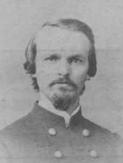
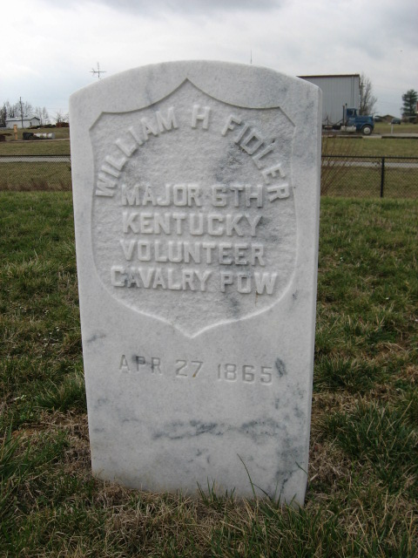
(Example of a soldier that died.)
Last Name
First Name
Rank
Company
Unit Number, State and Type
Fidler
William H.
Major
Field and Staff
6th Kentucky Cavalry
Fate:
DIED
Age at time of disaster:
22

Slide 12
Sources which list this person as being on the Sultana, April 24-27, 1865
Berry Loss of the Sultana list of soldiers known to be on the Sultana: as Fiddler, 5 KY Cav.
Fold3.com – Mother’s Pension File
Kentucky Adjutant General’s Reports - Captured near Tuscaloosa, Alabama, April 6th, 1865; killed on steamer Sultana April 28th, 1865, near Memphis. Tennessee.
Fold3.com – Widows Pension (see File)
Vicksburg Herald List (as 5 KY Cav.)
Fold3.com - Commissioned Officers List
Findagrave.com – Born unknown, Died April 27, 1865. Grave at Lebanon National Cemetery, Lebanon, KY.
Ancestry.com – Born about 1835, Died April 27, 1865.
Fold3.com – Service Records – Company Muster Roll – Born about 1842.
US Registers of Deaths of Volunteers, Kentucky, Vol. 1, p. 114. Died April 28, 1865 From Injuries rec’d by Explosion.
Record of Officers & Men on Board the Steamer Sultana (page 202) – PERISHED (as Fiddler)
The Memphis Argus, May 7, 1865, p. 2 – Brother searching for body.
Personal File – Perrin’s Biographical Sketches – Mentioned in biography of brother Jesse P. Fidler.
Personal File – Croxton’s Raid by Miller – Contains biography on Fidler.
McCown Reminiscence in Berry Loss of the Sultana – describes death of Fidler.
Personal File, The Sultana Remembered, Spring 2006. Biography by Stephen Wright.

Slide 13
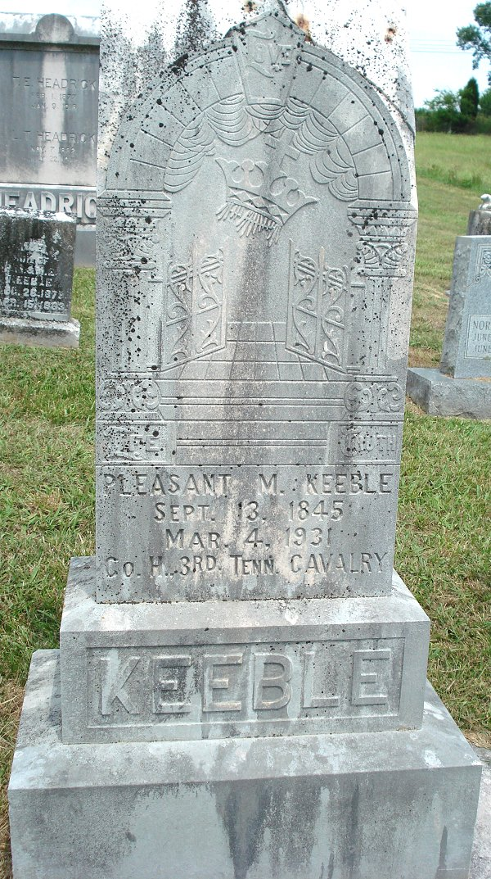
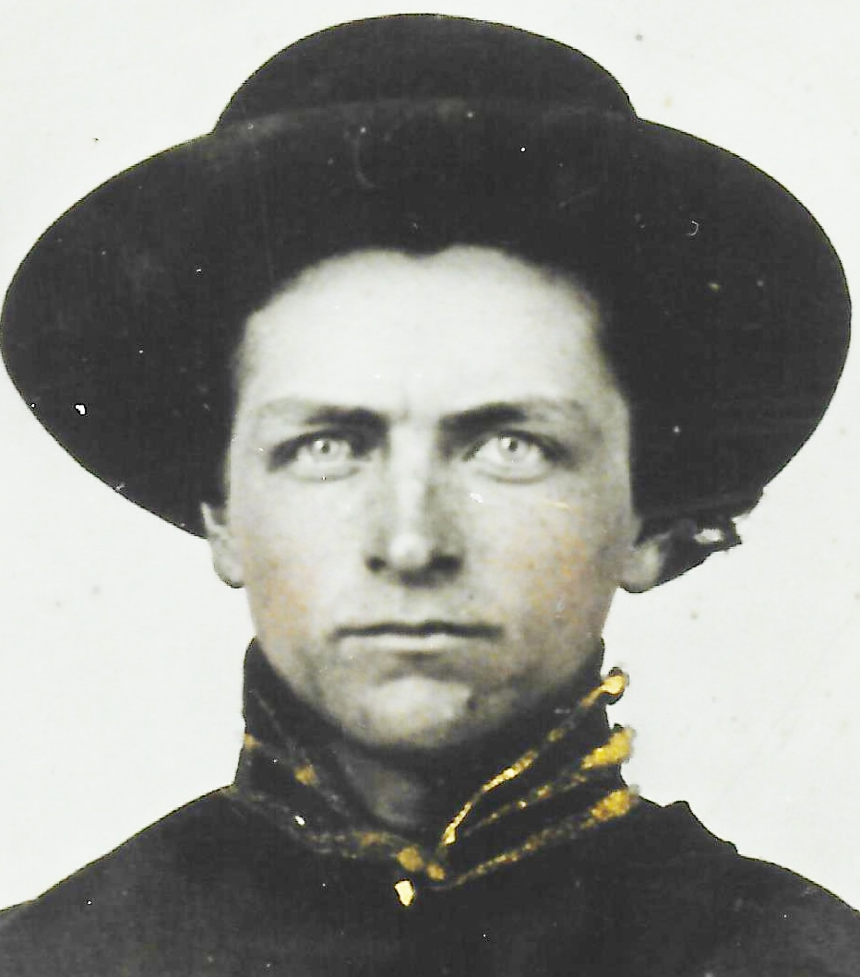
(Example of a soldier that survived.)
Last Name
First Name
Rank
Company
Unit Number, State and Type
Keeble
Pleasant Marion
Private
H
3rd Tennessee Cavalry
Fate:
Survived
Age at time of disaster:
19

Slide 14
Sources which list this person as being on the Sultana, April 24-27, 1865
Memphis Argus – Adams Hospital List.
Memphis Daily Bulletin, Adams Hospital List.
Daily Missouri Democrat, Adams Hospital -Chilled.
Daily Missouri Republican, Adams Hospital List – Chilled.
Cincinnati Daily Commercial, Adams Hospital List.
Cincinnati Daily Gazette, Adams Hospital List.
Camp Fisk List (April 4) as Peeble
Berry Loss of the Sultana - Still Living in 1892 List: as Kibble
Tennessee Adjutant General’s Report – Mus out June 10 65 under G O 77 W D A G O dated Apr 28 65
Fold3.com – Pension Record Card – Died March 4, 1931, at Knoxville, TN.
Fold3.com – Service Records – POW Memorandum – Survived disaster Steamer Sultana April 27, 65 “Chill.” Reported at Camp Chase, O. May 3/65.
Ancestry.com – Born Sept. 13, 1845, Died March 4. 1931. (Younger brother of John H. Keeble)
Findagrave.com – Born Sept. 13, 1845, Died March 4, 1931. Buried at Eusebia Cemetery, Prospect, TN.
Personal File - Obituary Notice – Kingsport [TN] Times, March 4, 1931. Died March 4, 1931. Mentions Sultana.
Chicago Archives – “Str. ‘Sultana’ Survivors” List. (as P. Kuble)
Fold3.com – TN List – (as Peeble) Reported at Camp Chase, O., May 3, ’65.
Record of Officers & Men on Board the Steamer Sultana (page 188) – Survived (as Kuble)

Slide 15
Sources which list this person as being on the Sultana, April 24-27, 1865
Roll of TN Div. of Sultana Sur. Assoc.
Obituary Notice – Kingsport [TN] Times March 4, 1931, p. 6.
List of Federal prisoners who survived the Sultana – Chilled.
Cincinnati Weekly Commercial, May 4, 1865 - Known to be on the Sultana.
Personal File – Reminiscences written by Si Keeble, his son, 1987.
Personal File – Newspaper Account in The Knoxville News-Sentinel, April 23, 1929.
Personal File – Newspaper account in The Knoxville Journal, April 27, 1930.
Personal File of A. Peery – reminiscence in The Maryville [TN] Enterprise, April 30, 1975. Mentions J. Lackey, James and Wallace Millsaps, Jacob Finger, P. Keeble, R. Moore, L.M. Kidd.
Personal File, Biography in The Sultana Remembered Newsletter, Summer, 1992 by Si Keeble. Mentions death of John Keeble.
Attended 1896 Reunion at Mount Olive – per Bob Davis, Knoxville. (as Kibble)

Slide 16
(Example of a soldier with no photograph or headstone photo.)
Last Name
First Name
Rank
Company
Unit Number, State and Type
Dunsmore
John Wilson “Wils”
Artificer
I
1st Michigan Engineers and Mechanics
Fate:
Lived
Age at time of disaster:
35
No known photograph
No known headstone

Slide 17
Sources which list this person as being on the Sultana, April 24-27, 1865
Memphis Argus – Adams Hospital List.
Memphis Daily Bulletin – Adams Hospital – (on Gayoso List).
Cincinnati Daily Commercial, Adams Hospital (on Gayoso List).
Daily Missouri Democrat, Adams Hospital -Strain in right foot.
Daily Missouri Republican, Adams Hospital List – Strain in right foot.
Cincinnati Daily Gazette, Adams Hospital (on Gayoso List)
Reminiscence in Berry Loss of the Sultana
Berry, Loss of the Sultana, List of soldiers known to have been on the Sultana.
Memphis Daily Bulletin, Fort Pickering List
Daily Missouri Democrat, Fort Pickering List.
Cincinnati Daily Enquirer, Fort Pickering List.
Cincinnati Daily Commercial, Fort Pickering List.
Berry, Loss of Sultana, list of soldiers Still Living in 1892
Record of Service of Michigan Volunteers in the Civil War – Taken prisoner Aug. 18, 1864. Discharged at Detroit, Mich., June 5, 1865. (Vol. 43, p. 61)
Chicago Archives – “Str. ‘Sultana’ Survivors” List.
Fold3.com – MI List – Reported at Camp Chase, O., May 3, ’65.
Record of Service of Michigan Volunteers in the Civil War – Born about 1829.
Ancestry.com – Born Feb. 18, 1829, Died July 19, 1908, Summerfield Twp., Clare Co., MI.

Slide 18
Sources which list this person as being on the Sultana, April 24-27, 1865
Record of Officers & Men on Board the Steamer Sultana (page 171) - Survived – See Pen. Case Jany 6/76.
List of Federal prisoners who survived the Sultana – Sprain.
Cincinnati Weekly Commercial, May 4, 1865 - Known to be on the Sultana – (as Pvt.)
Michigan List – Detroit Advisor and Tribune, May 30, 1865 – Survived

Slide 19
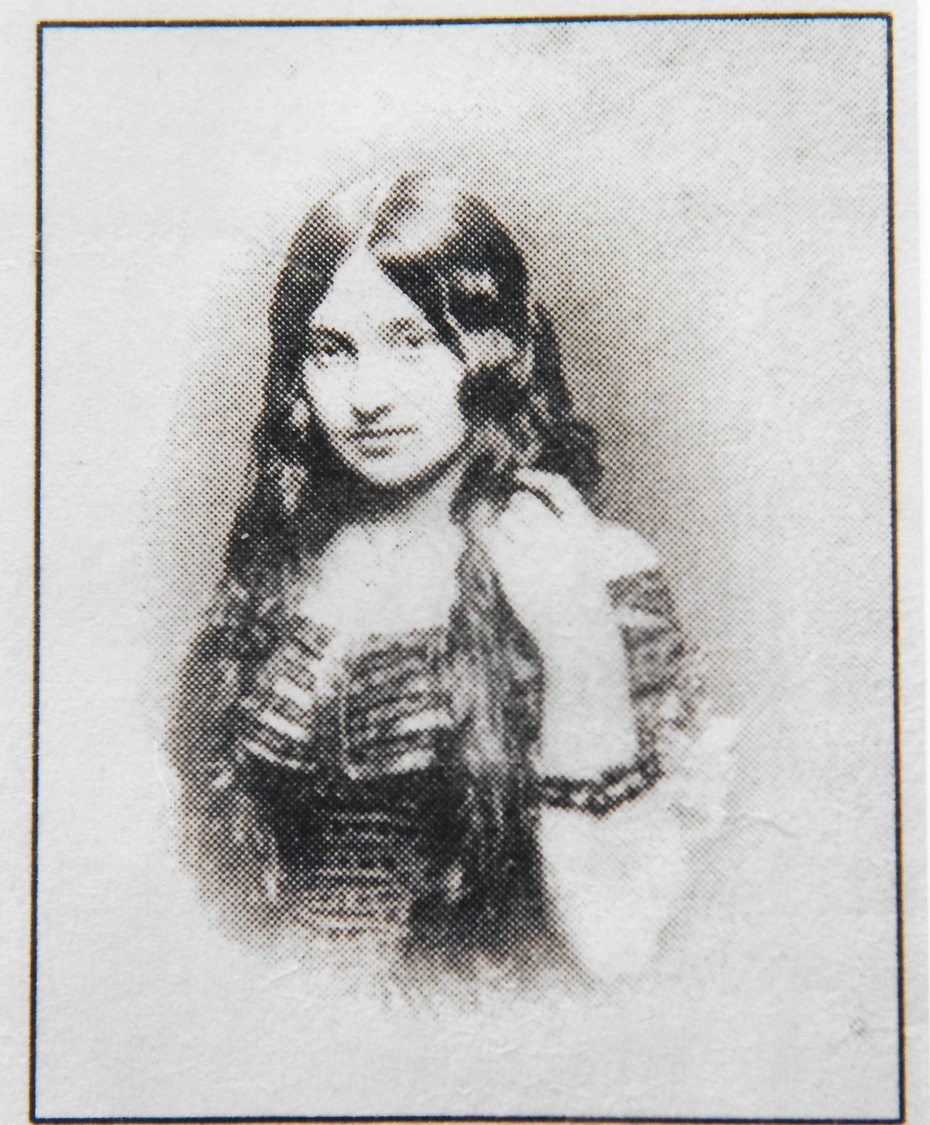
(Example of a passenger who died.)
Last Name
First Name
Rank
Company
Unit Number, State and Type
Hardin
Hannah Sophia nee Osborn
Passenger
Fate:
DIED
Age at time of disaster:
23
No known headstone

Slide 20
Sources which list this person as being on the Sultana, April 24-27, 1865
Wife of Seth Hardin.
Married 22 Dec. 1864
Ancestry.com – Born 1842 in Iowa, Died Aril 27, 1865.
St. Louis Daily Missouri Republican, April 29, 1865, p.3 – mentioned as lost.
The Memphis Argus, April 28, 1865, p. 3 – Mentioned as lost.
Personal File – Newspaper article – Denver [CO] Post, April 23, 1912 – chronicles escape from Sultana and loss of wife.

Slide 21
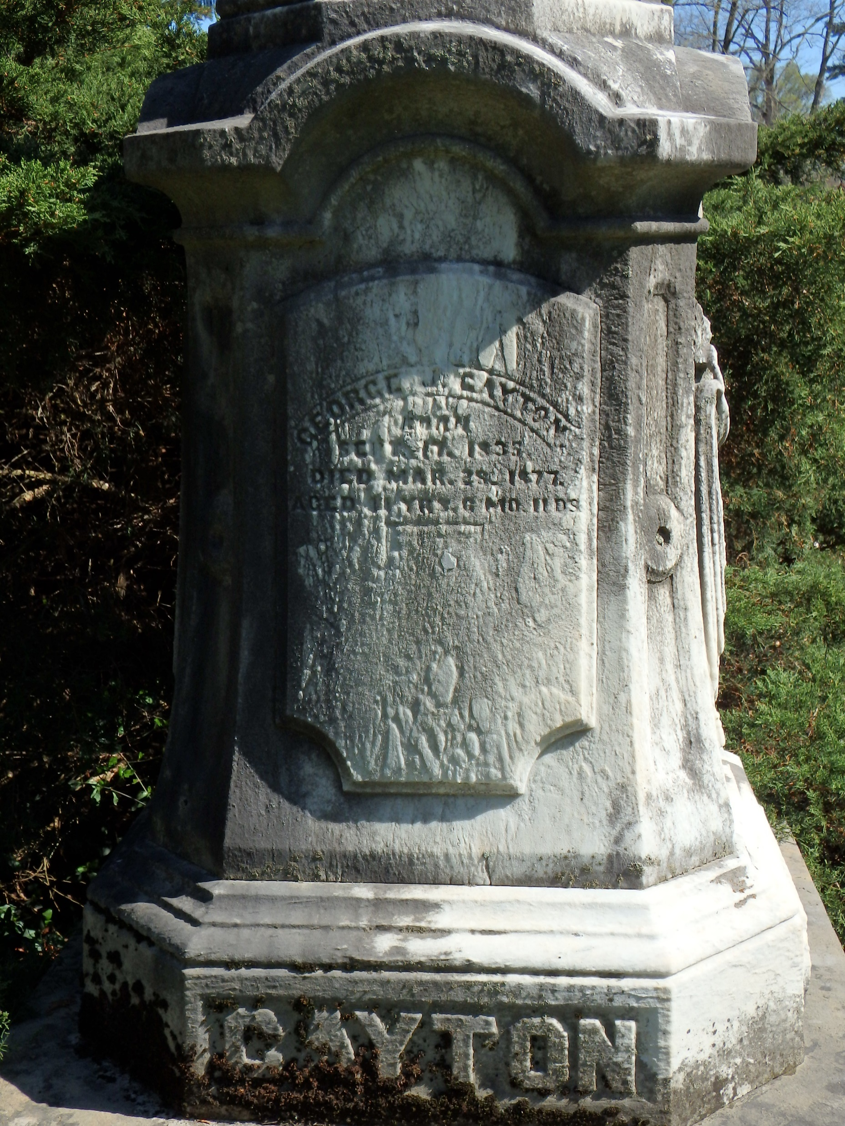
(Example of a crew person who survived.)
Last Name
First Name
Rank
Company
Unit Number, State and Type
Cayton
George J.
Crew member - pilot
Fate:
Lived
Age at time of disaster:
29
No known photograph

Slide 22
Sources which list this person as being on the Sultana, April 24-27, 1865
List of people rescued by the steamboat Pocahontas
St. Louis Daily Missouri Democrat, April 29, 1865 – as Coyton.
St. Louis Daily Missouri Democrat, April 29, 1865 – Mentions being rescued.
St. Louis Daily Missouri Republican, April 29, 1865, p.3 – mentioned as lost.
The Memphis Argus, April 28, 1865, p. 3 - Newspaper Account.
Personal File – Testimony at Speed Trial.
Wintringer reminiscence in Berry, Loss of the Sultana. Mentions Cayton.
Ancestry.com – U.S. City Directory, 1822-1999 – St. Louis, MO, 1871 – Cayton, George J., Pilot.
Ancestry.com – 1870 United States Federal Census – St. Louis, MO – Cayton, George, 40 yrs old, occupation: Pilot (river), born in Illinois. Married to Mary Cayton (35), son George (8)
Findagrave.com – Born Sept. 17, 1835, Warsaw, IL, Died March 28, 1877, Cincinnati, OH. Buried at Spring Grove Cemetery, Cincinnati, OH.
Ancestry.com – U.S., Civil War Draft Registrations Records, 1863-1865 – Cayton, Geo. J., 28, Pilot.

